Slide 1
FINAL ASSESSment
Creative making: experience and physical computing

Slide 2

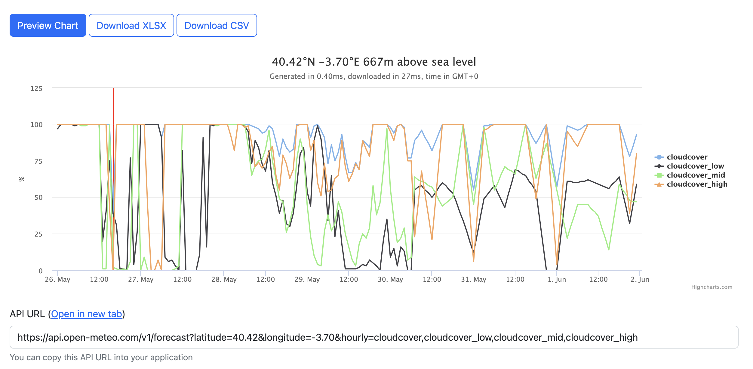
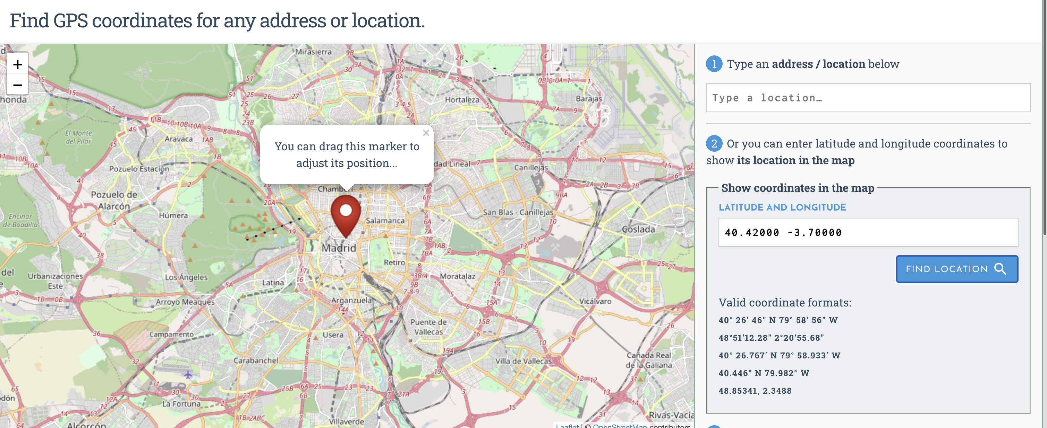
INITIAL PROCESS of IDEA
Inspired by climate change and making energy efficiency more accessible the idea of my project was to create a code that could be connected to this app/website https://eu5.fusionsolar.huawei.com/unisso/login.action?service=%2Funisess%2Fv1%2Fauth%3Fservice%3D%252Fnetecowebext%252Fhome%252Findex.html#/LOGIN which can give readings of how much energy is being used and how much energy there is in excess, then connecting that code to some LED lights in the shape of a battery which would be fully charged and green if there was a lot of excess power, half full and yellow for medium and red and barely charged for no excess energy. This process became quite complicated but I still gave it a shot trying to somehow use fusion_solar_py.client in a python file and somehow implementing the python file in Arduino but I struggled quite a lot.
This is what gave way to the final idea, two LED lights, one in the shape of a cloud and colour blue and another in the shape of a sun, colour yellow. The idea is to connect these LED’s to a code that reads from a weather API the cloud coverage, if it is less than 33% only the blue light which illuminates the cloud will light up, if it is between 33% and 66% then both would light up and if it is more than 66% only the yellow light would light up.

Slide 3
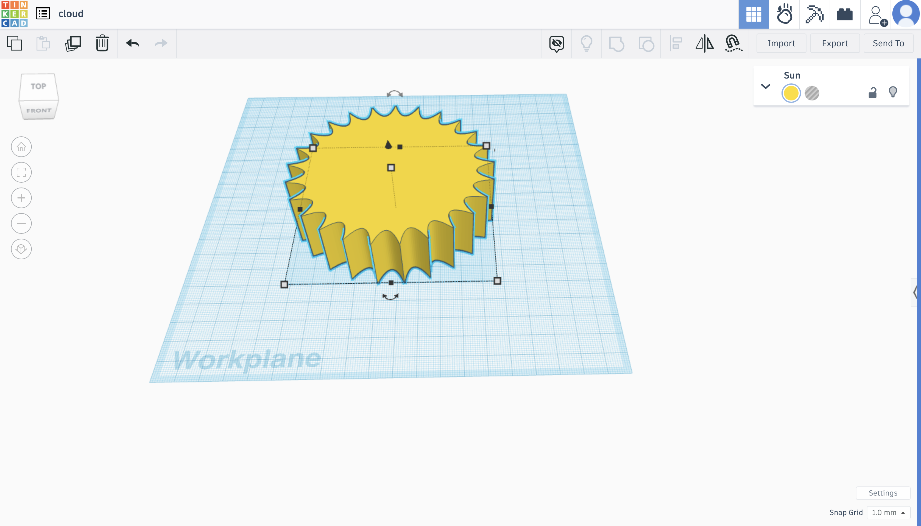
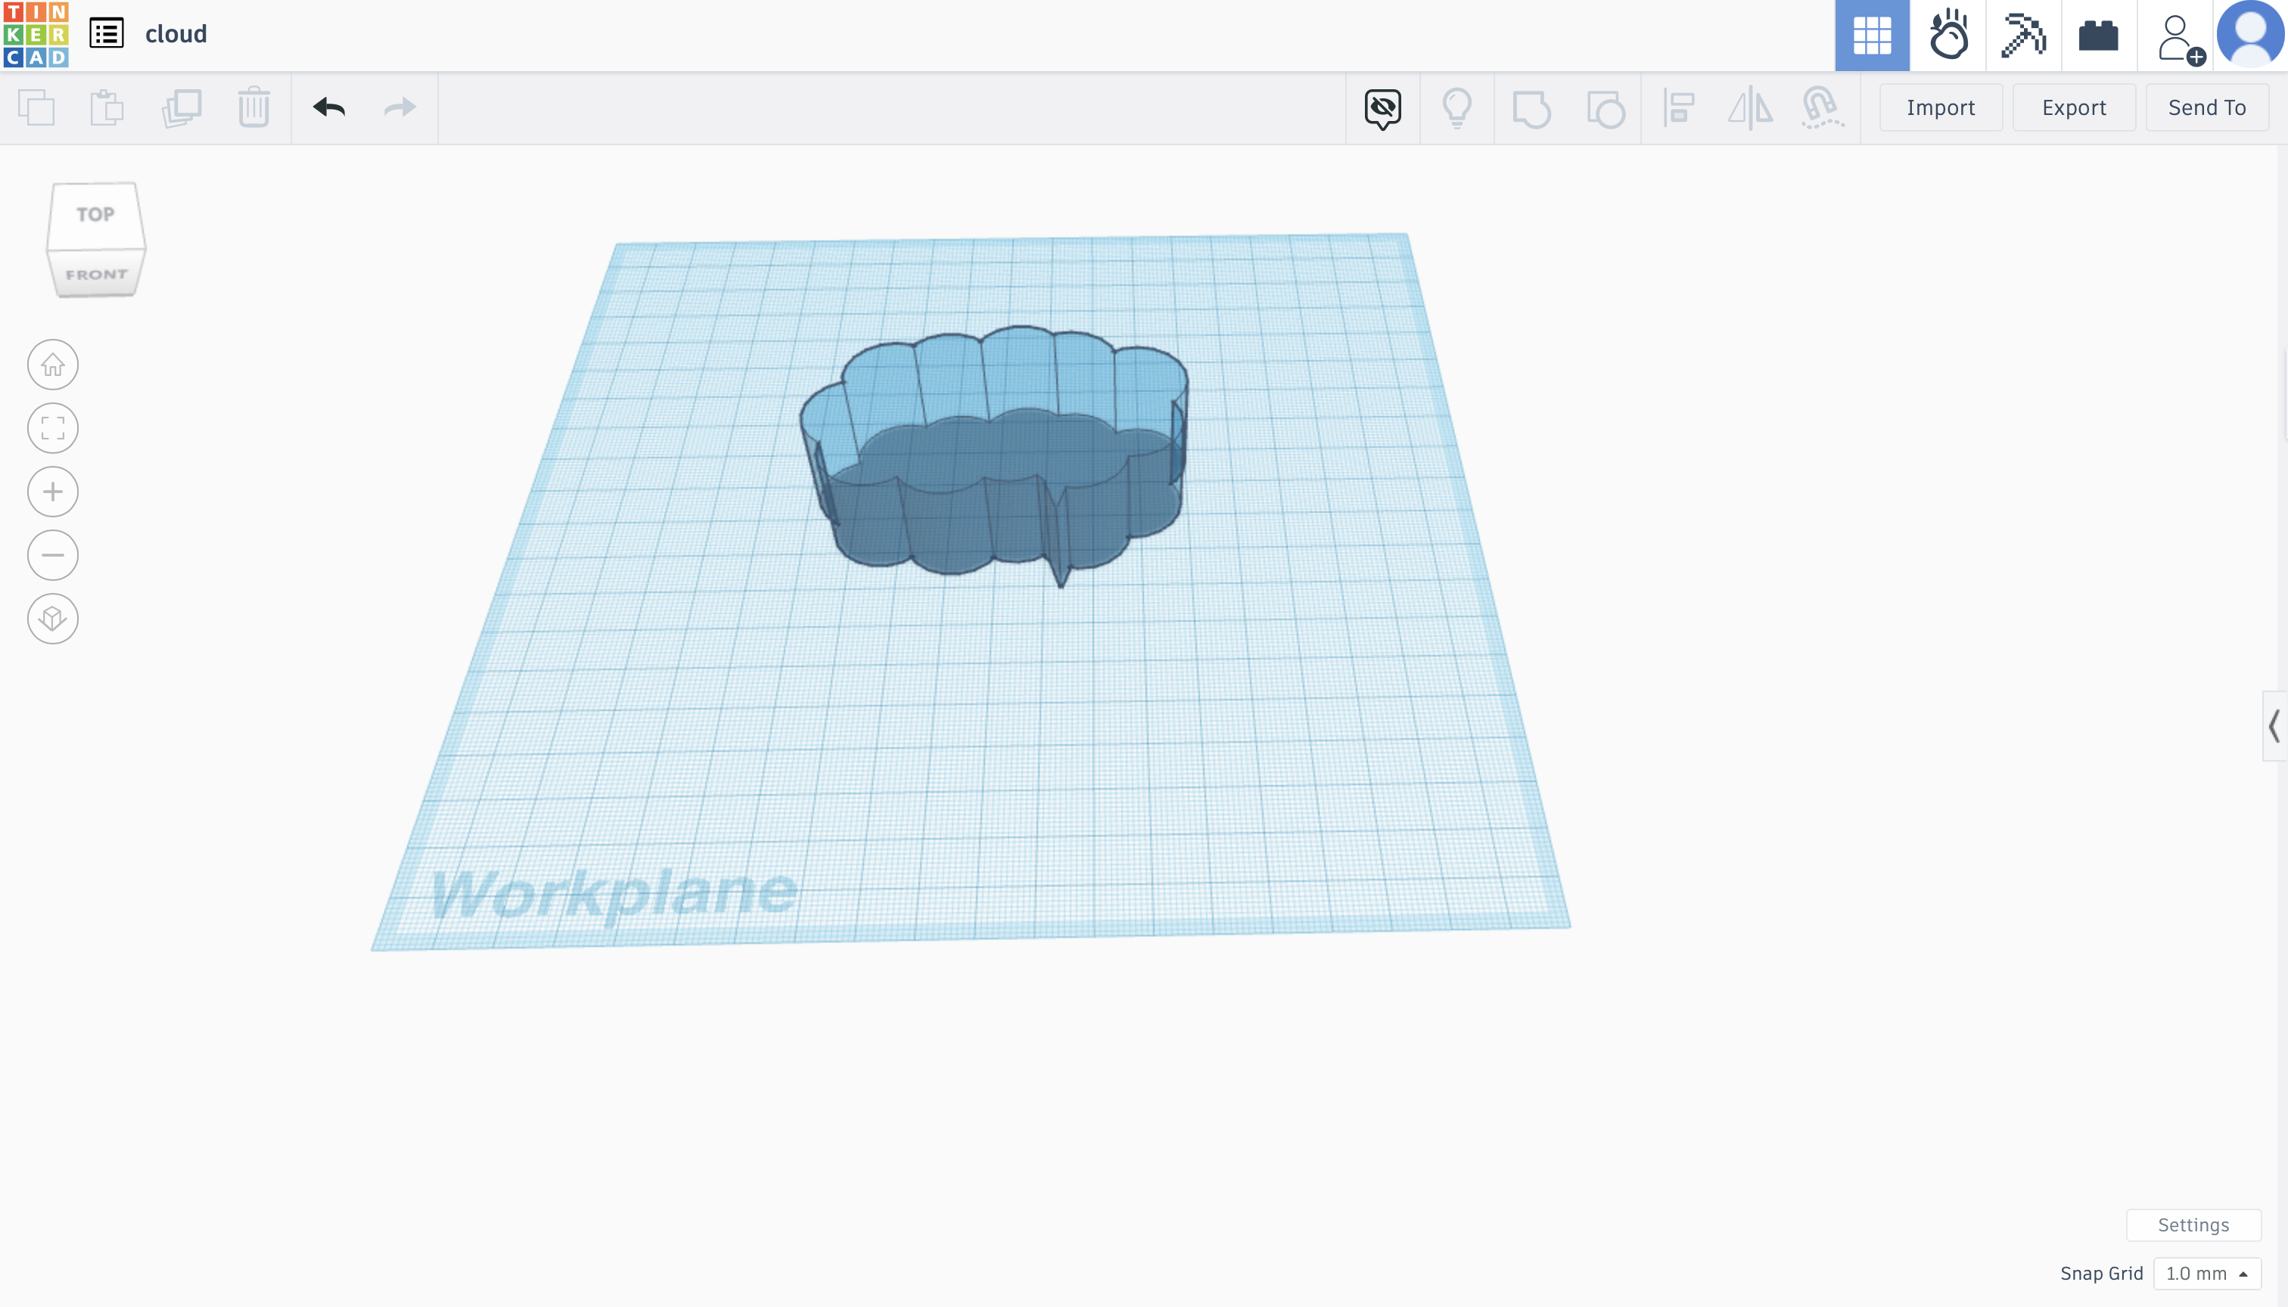
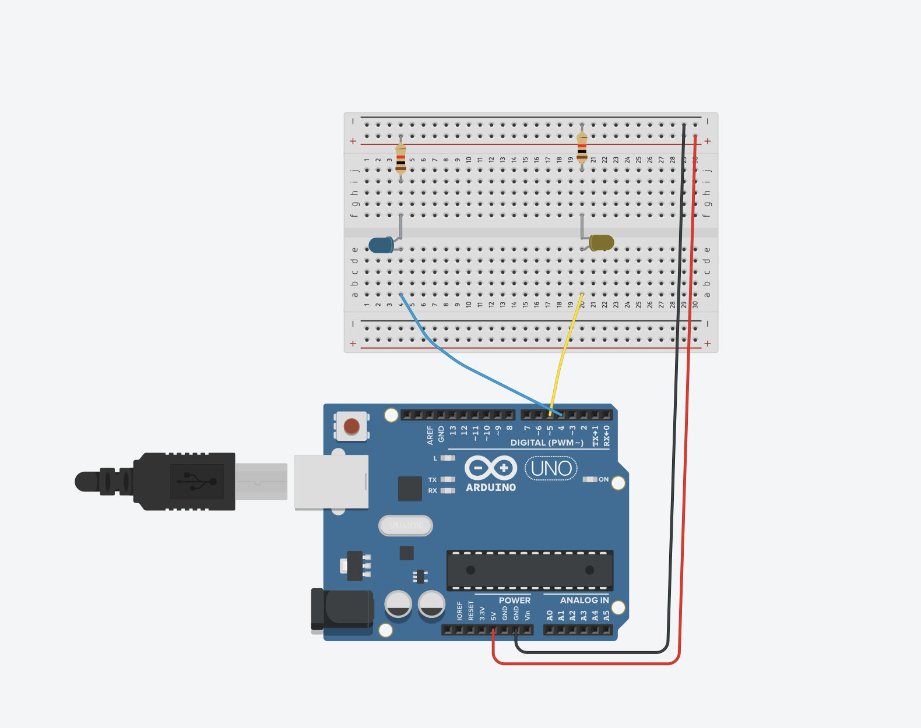
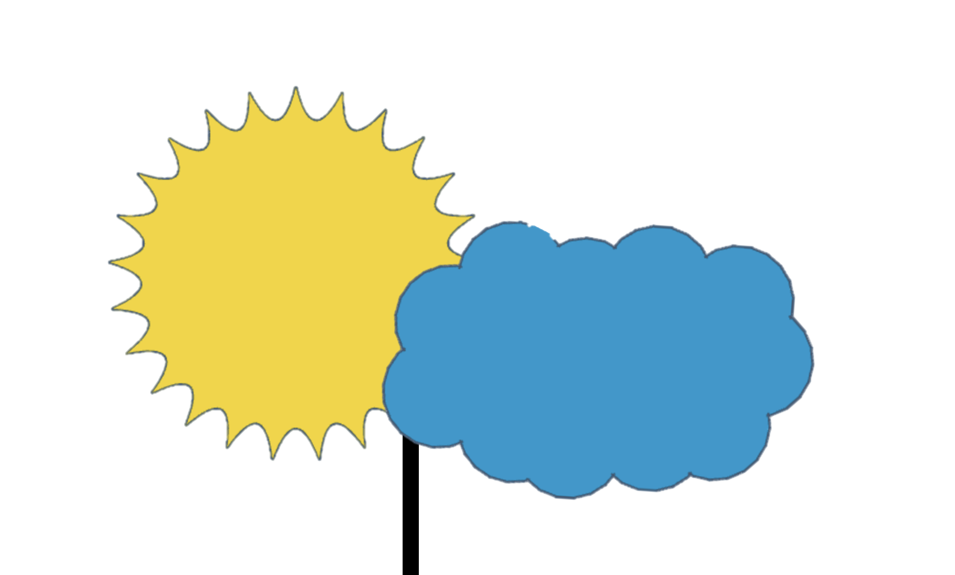
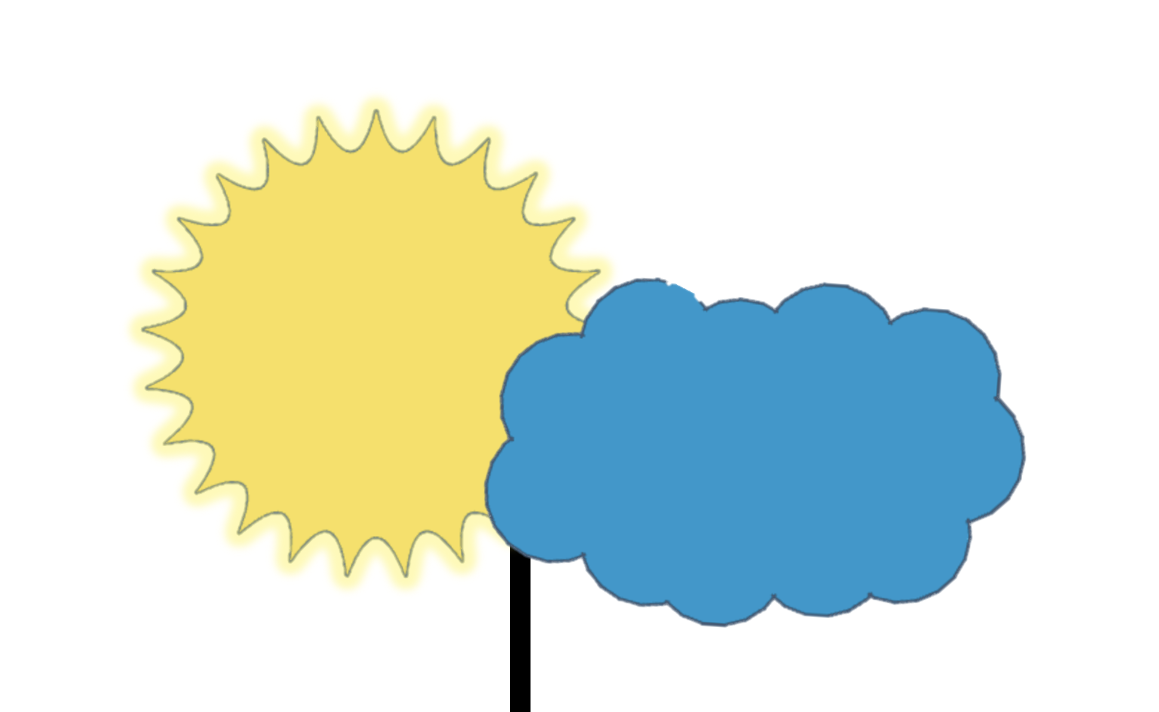
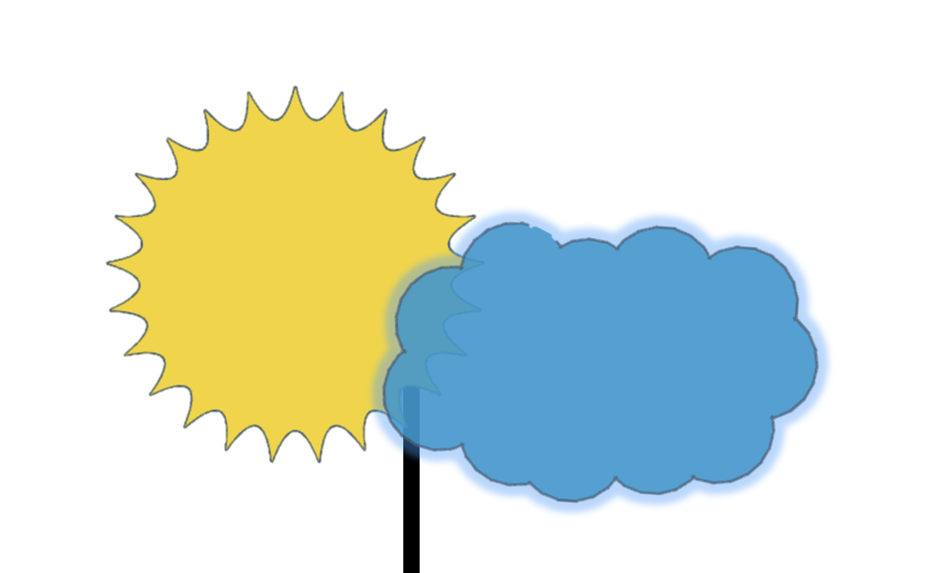
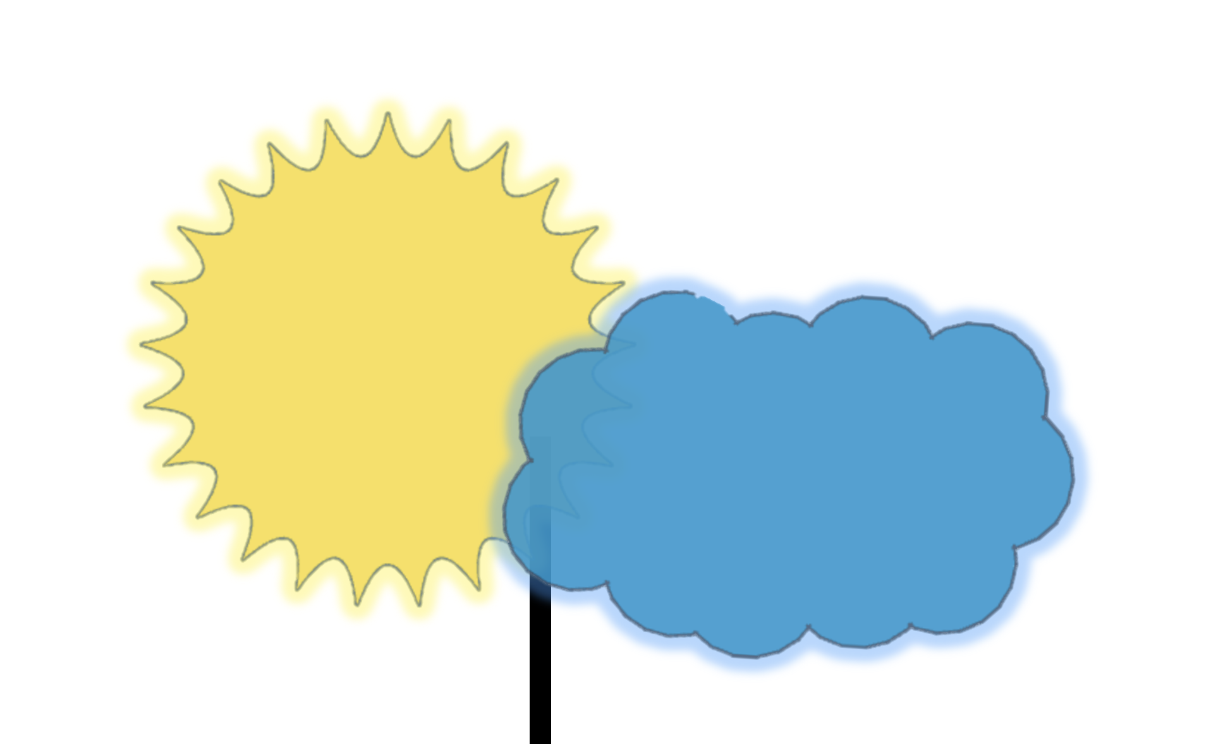
Design and development
I 3D printed the moon and sun and then stuck them together using a glue gun, in my model it is plugged into the computer but it would actually work by rechargeable batteries that can be recharged with the solar panels or plugged into a power outlet.
I have also included a tinkercad sketch of what it could look like on the breadboard.

Slide 4
issues
During the development, I used 3D printing to make the sun and cloud therefore the light wasn’t shining through properly so I had to cut out the top and cover it with a seethrough sheet of plastic. Another issue I encountered was that everything was running smoothly even after going back home, which I had to due to personal issues, but the day before the submission I went to run it to film it and the lights are not turning on and due to what the error message says I’m hoping it’s a problem with the connection to the Arduino board and not my code. I tried resetting the Arduino board and changing every cable I even ordered new LED’s but I think its because of the Leonardo board. I understand if you cannot pass me due to these issues (I did not include a video as I don’t have a proper video of it working but can send pictures of 3D models and everything if needed or an explanation using my voice over this powerpoint)

